Slide 1
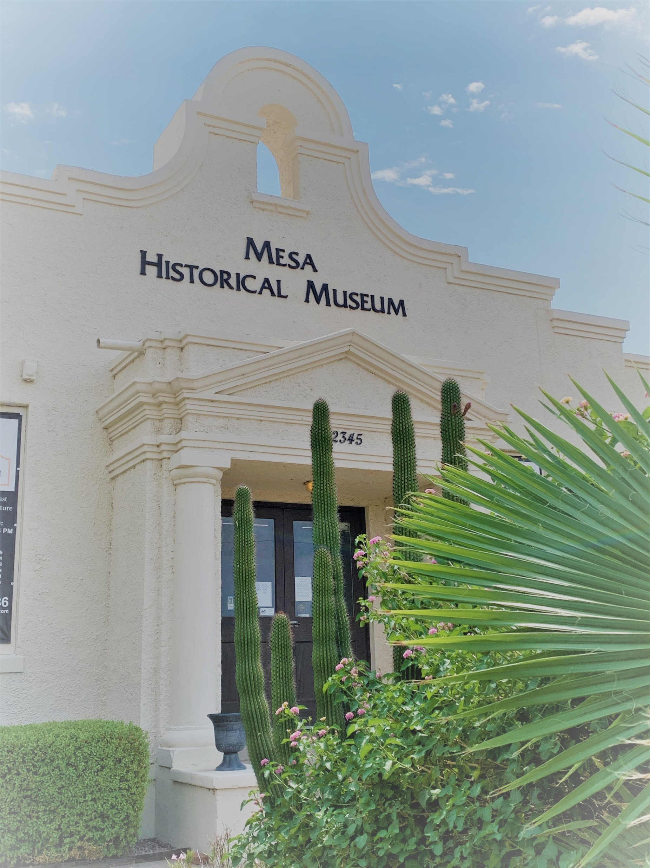
Mesa Historical Museum Presents:
Slide Show of
Mesa History Exhibit

Slide 2
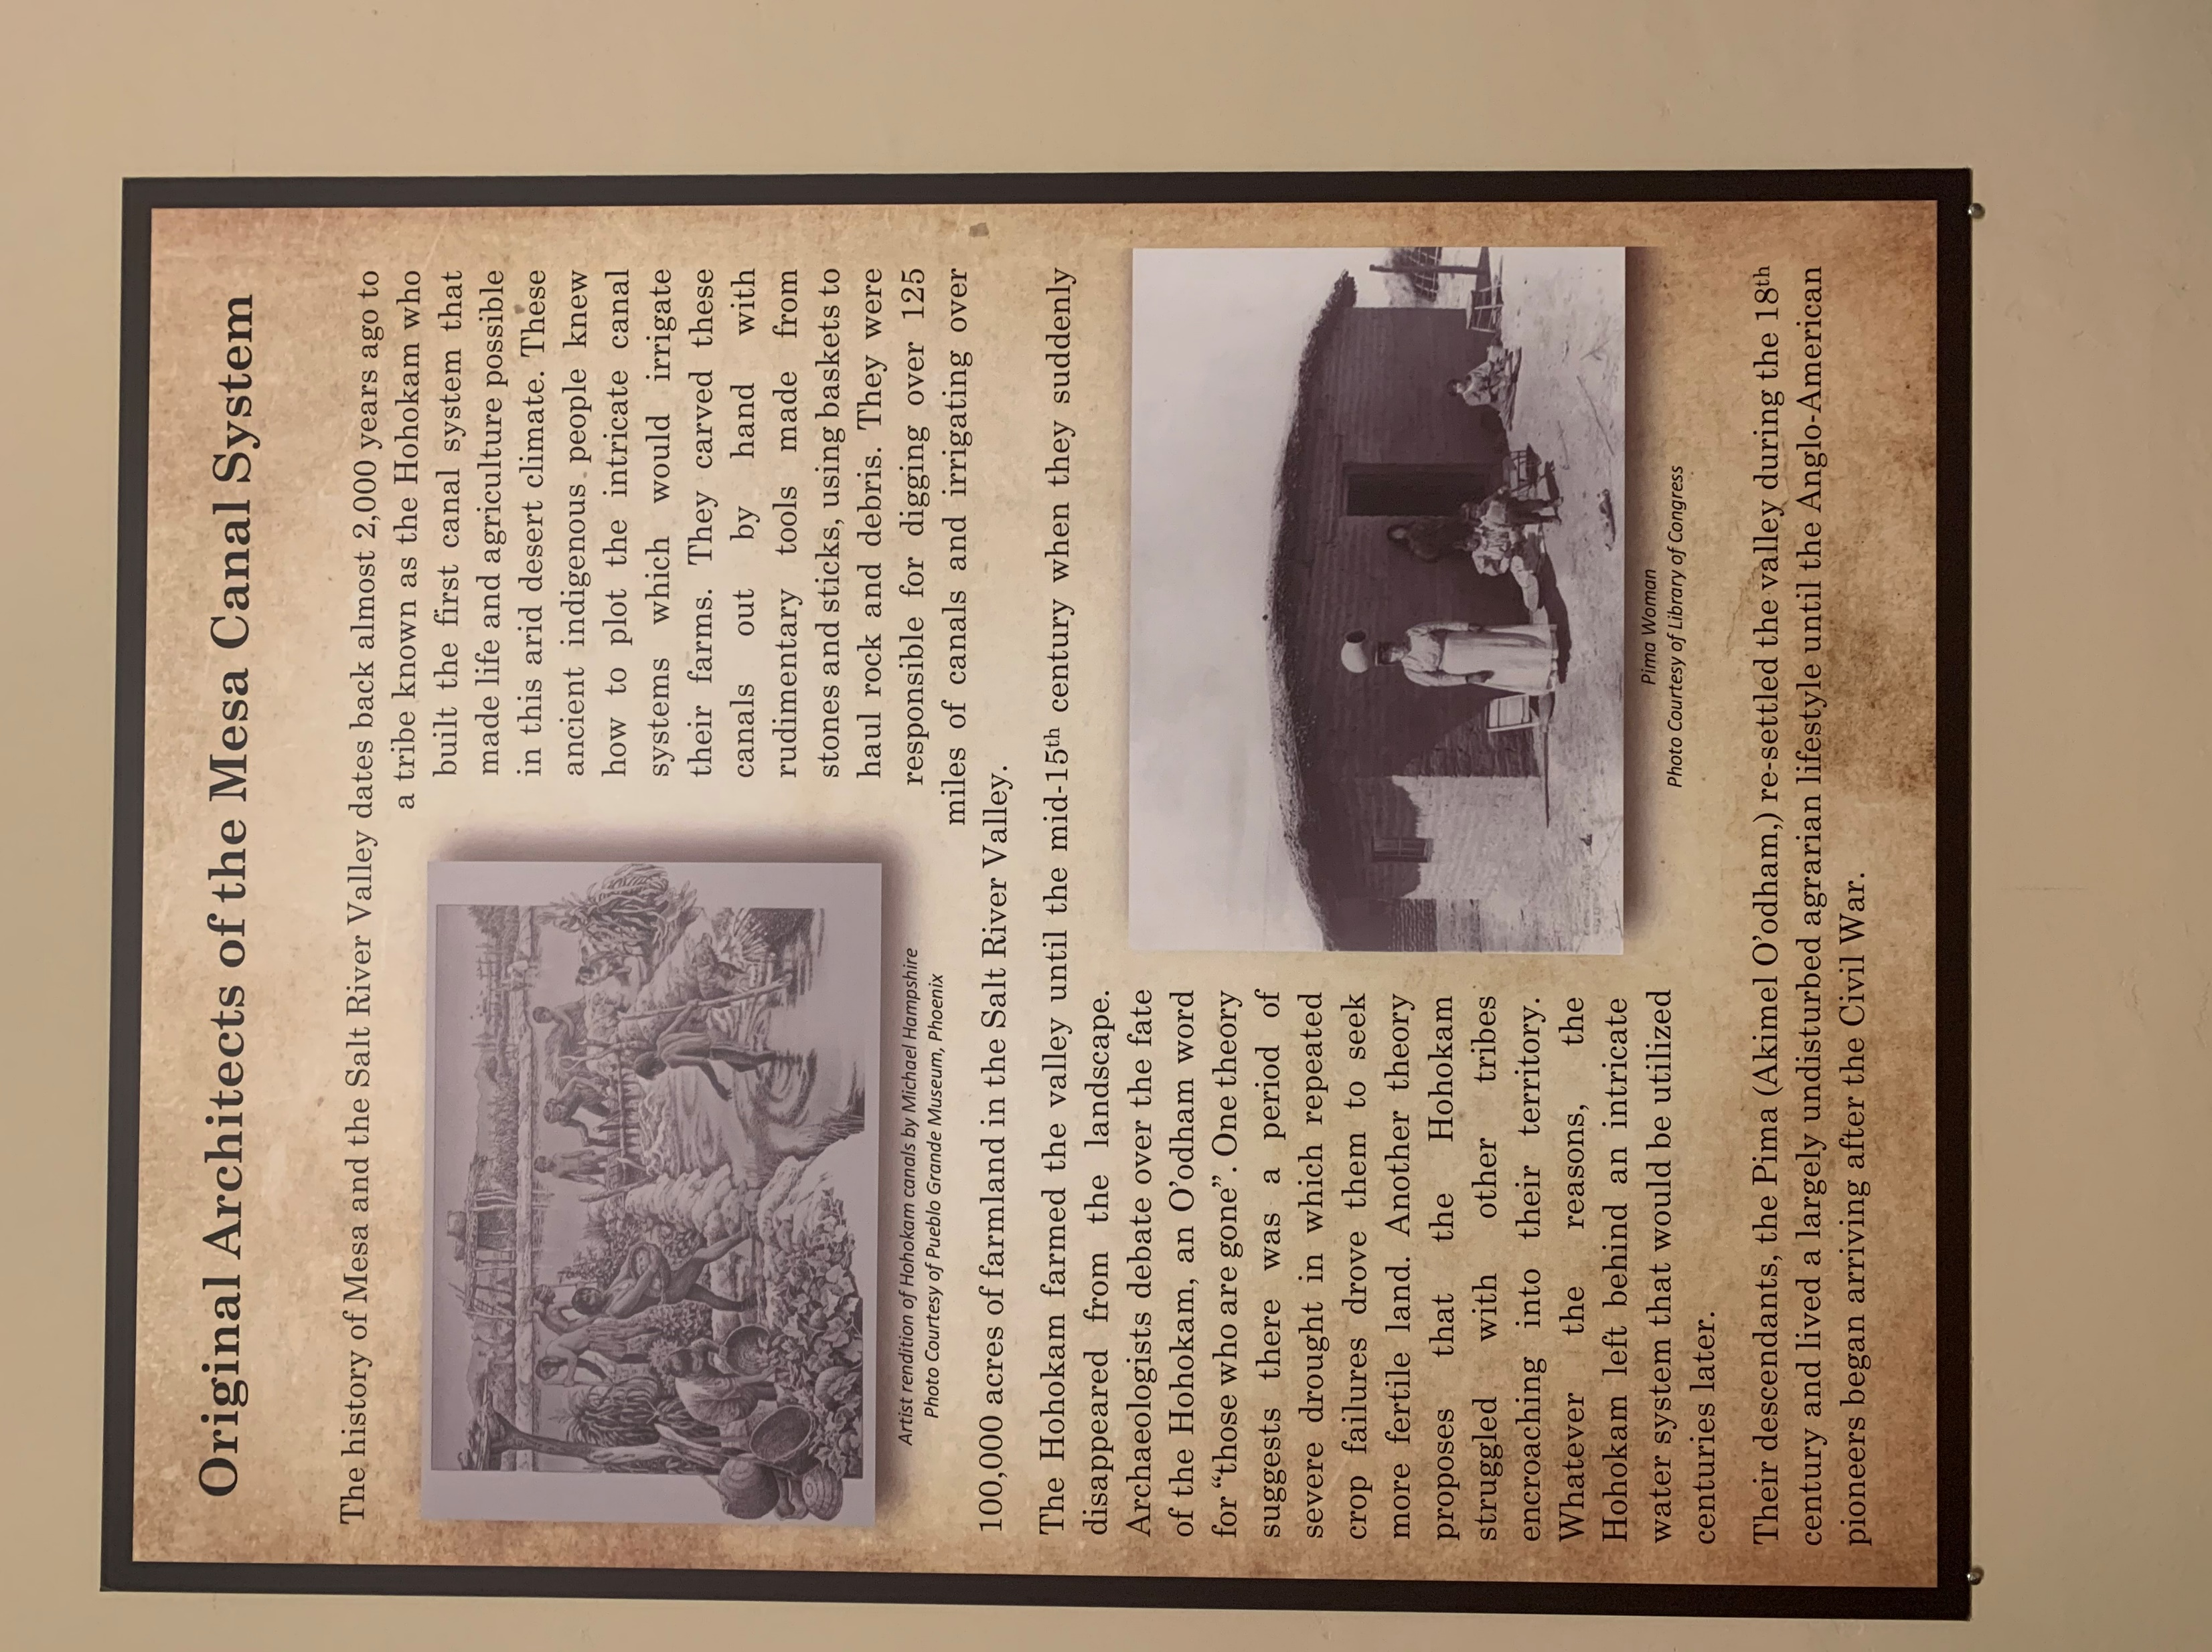

Slide 3
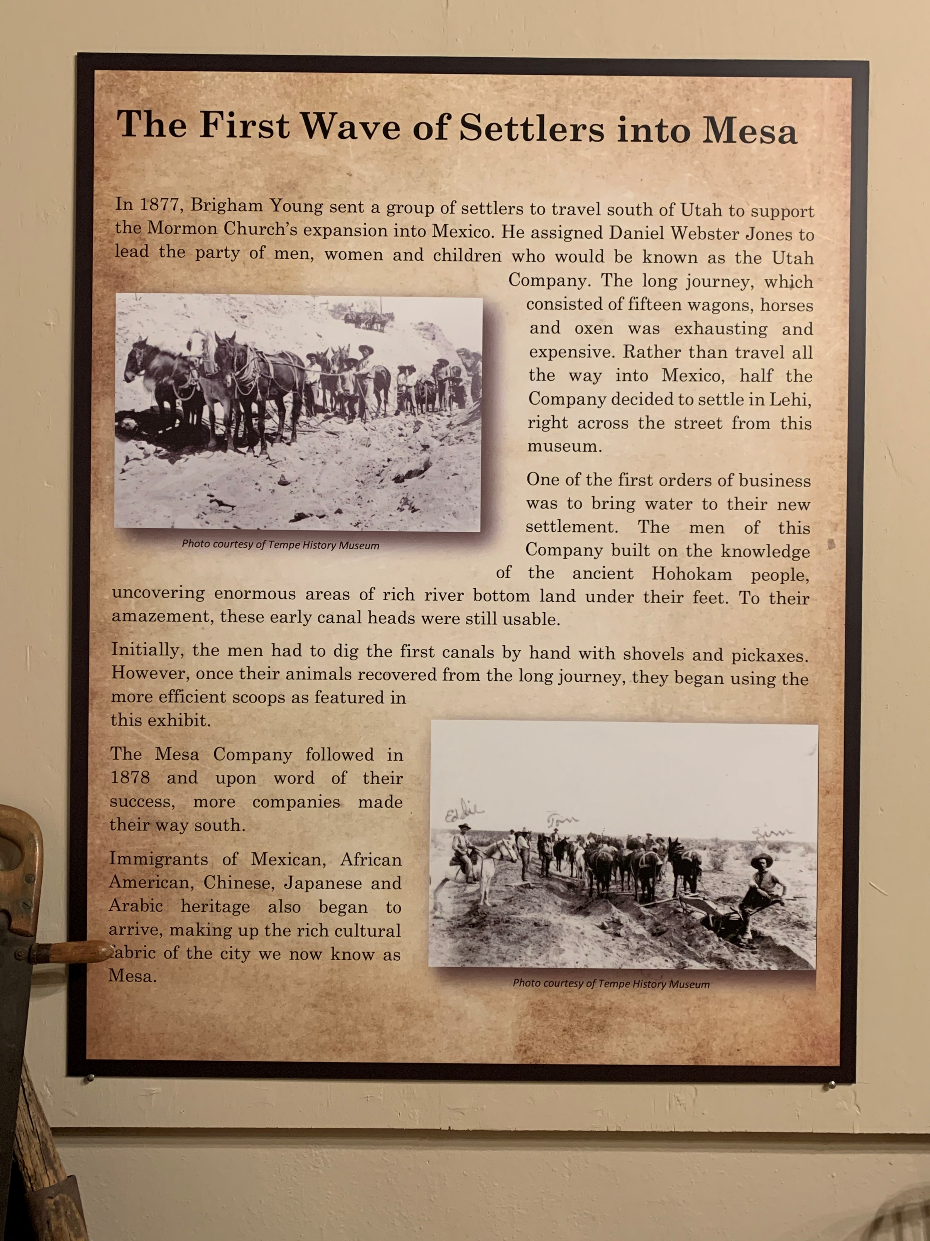

Slide 8
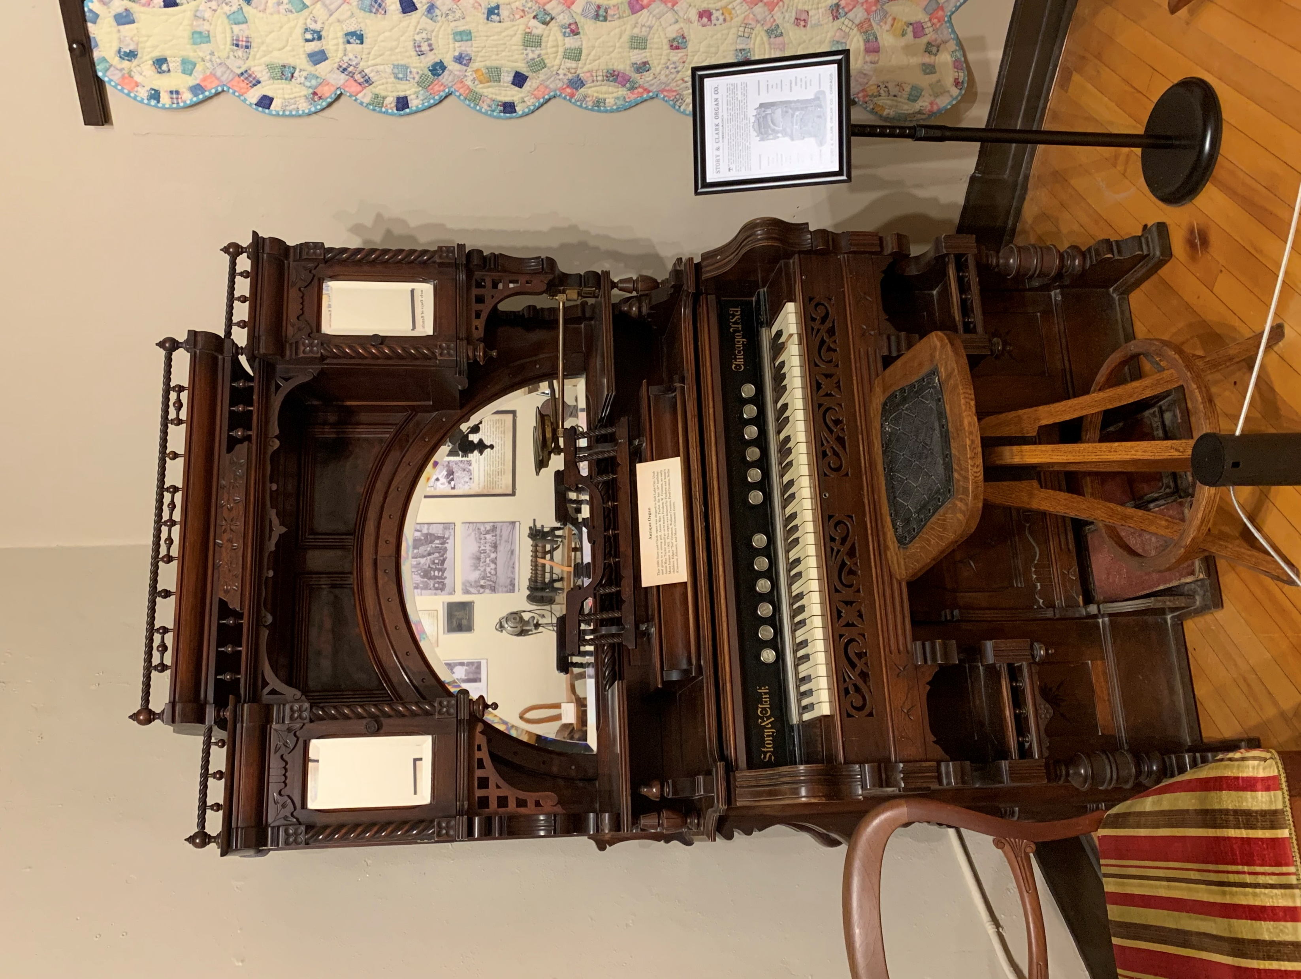
This 1893 Story and Clark organ was shipped to Salt Lake City, Utah and given to a young girl, Annie May Taylor, for her 15th birthday. Annie May Taylor would go on to marry Frederic W. Crismon, an early Mesa farmer, in 1902.

Slide 10
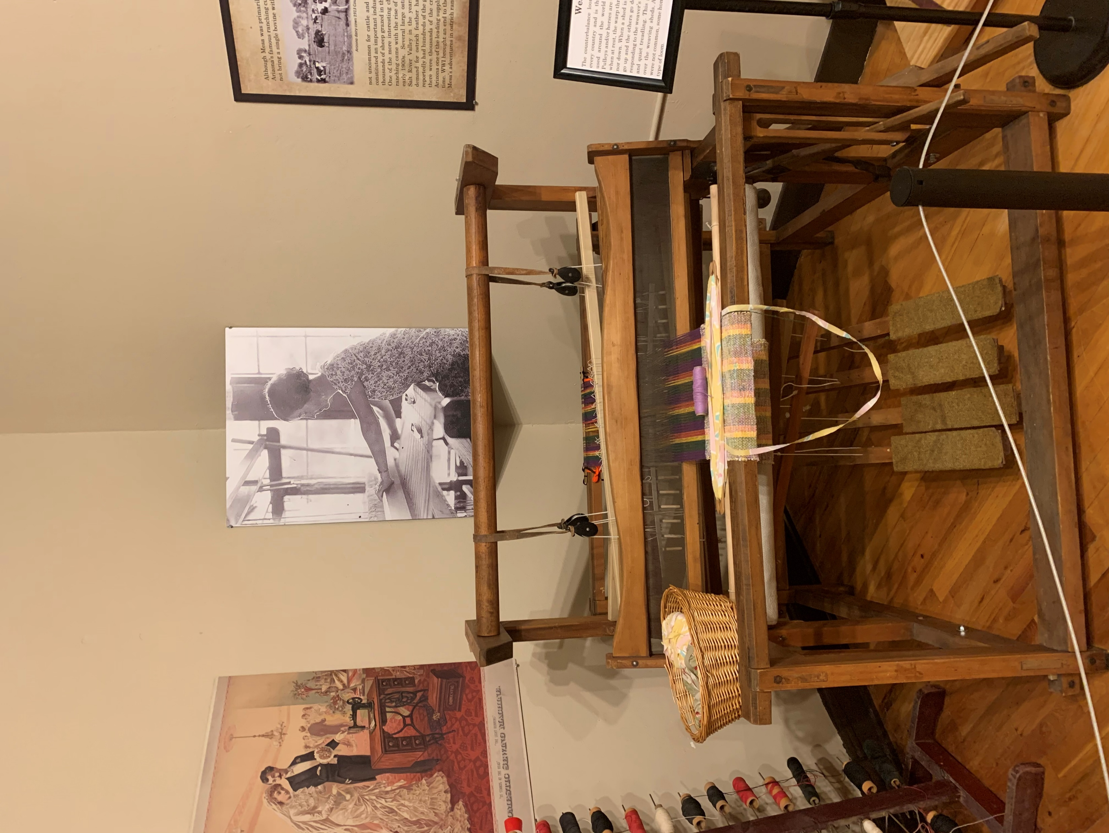
The counterbalance loom can be found in nearly every country and is the traditional type of loom used around the world and throughout history.

Slide 11
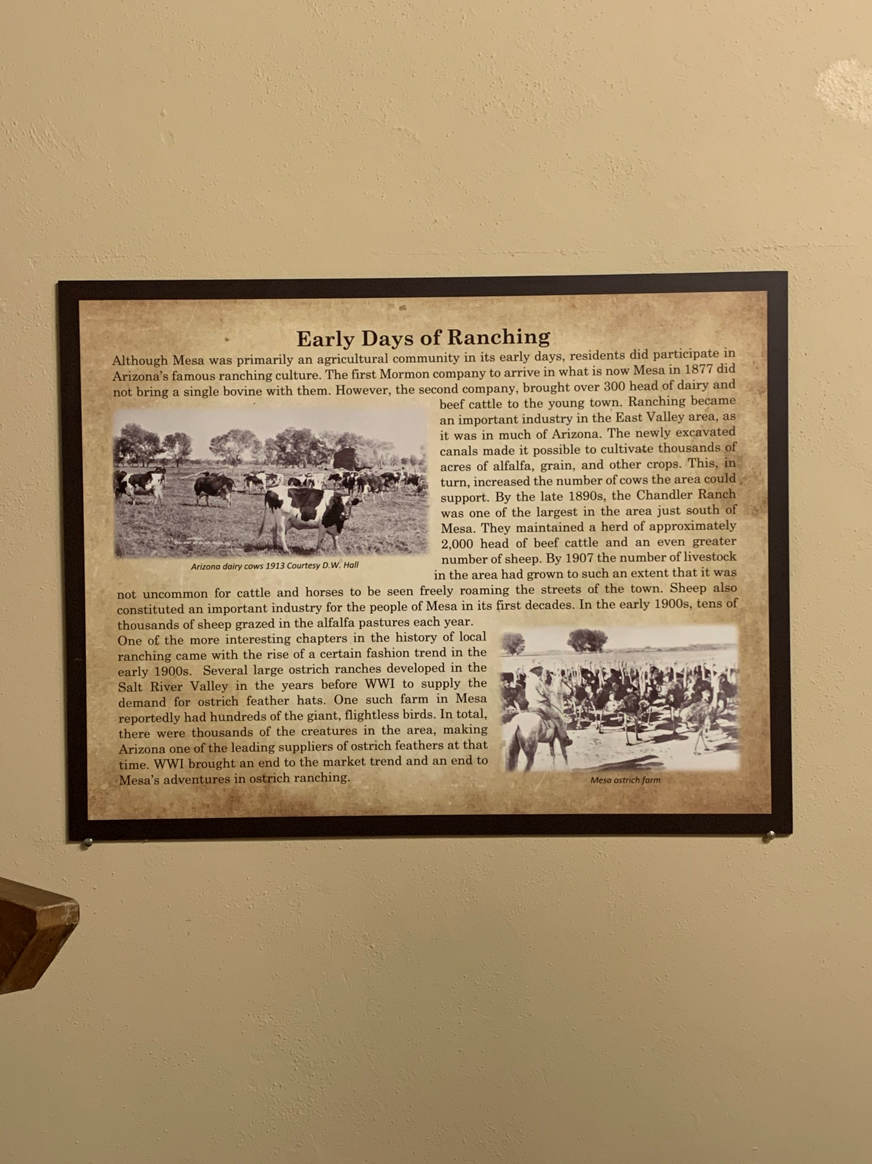

Slide 12
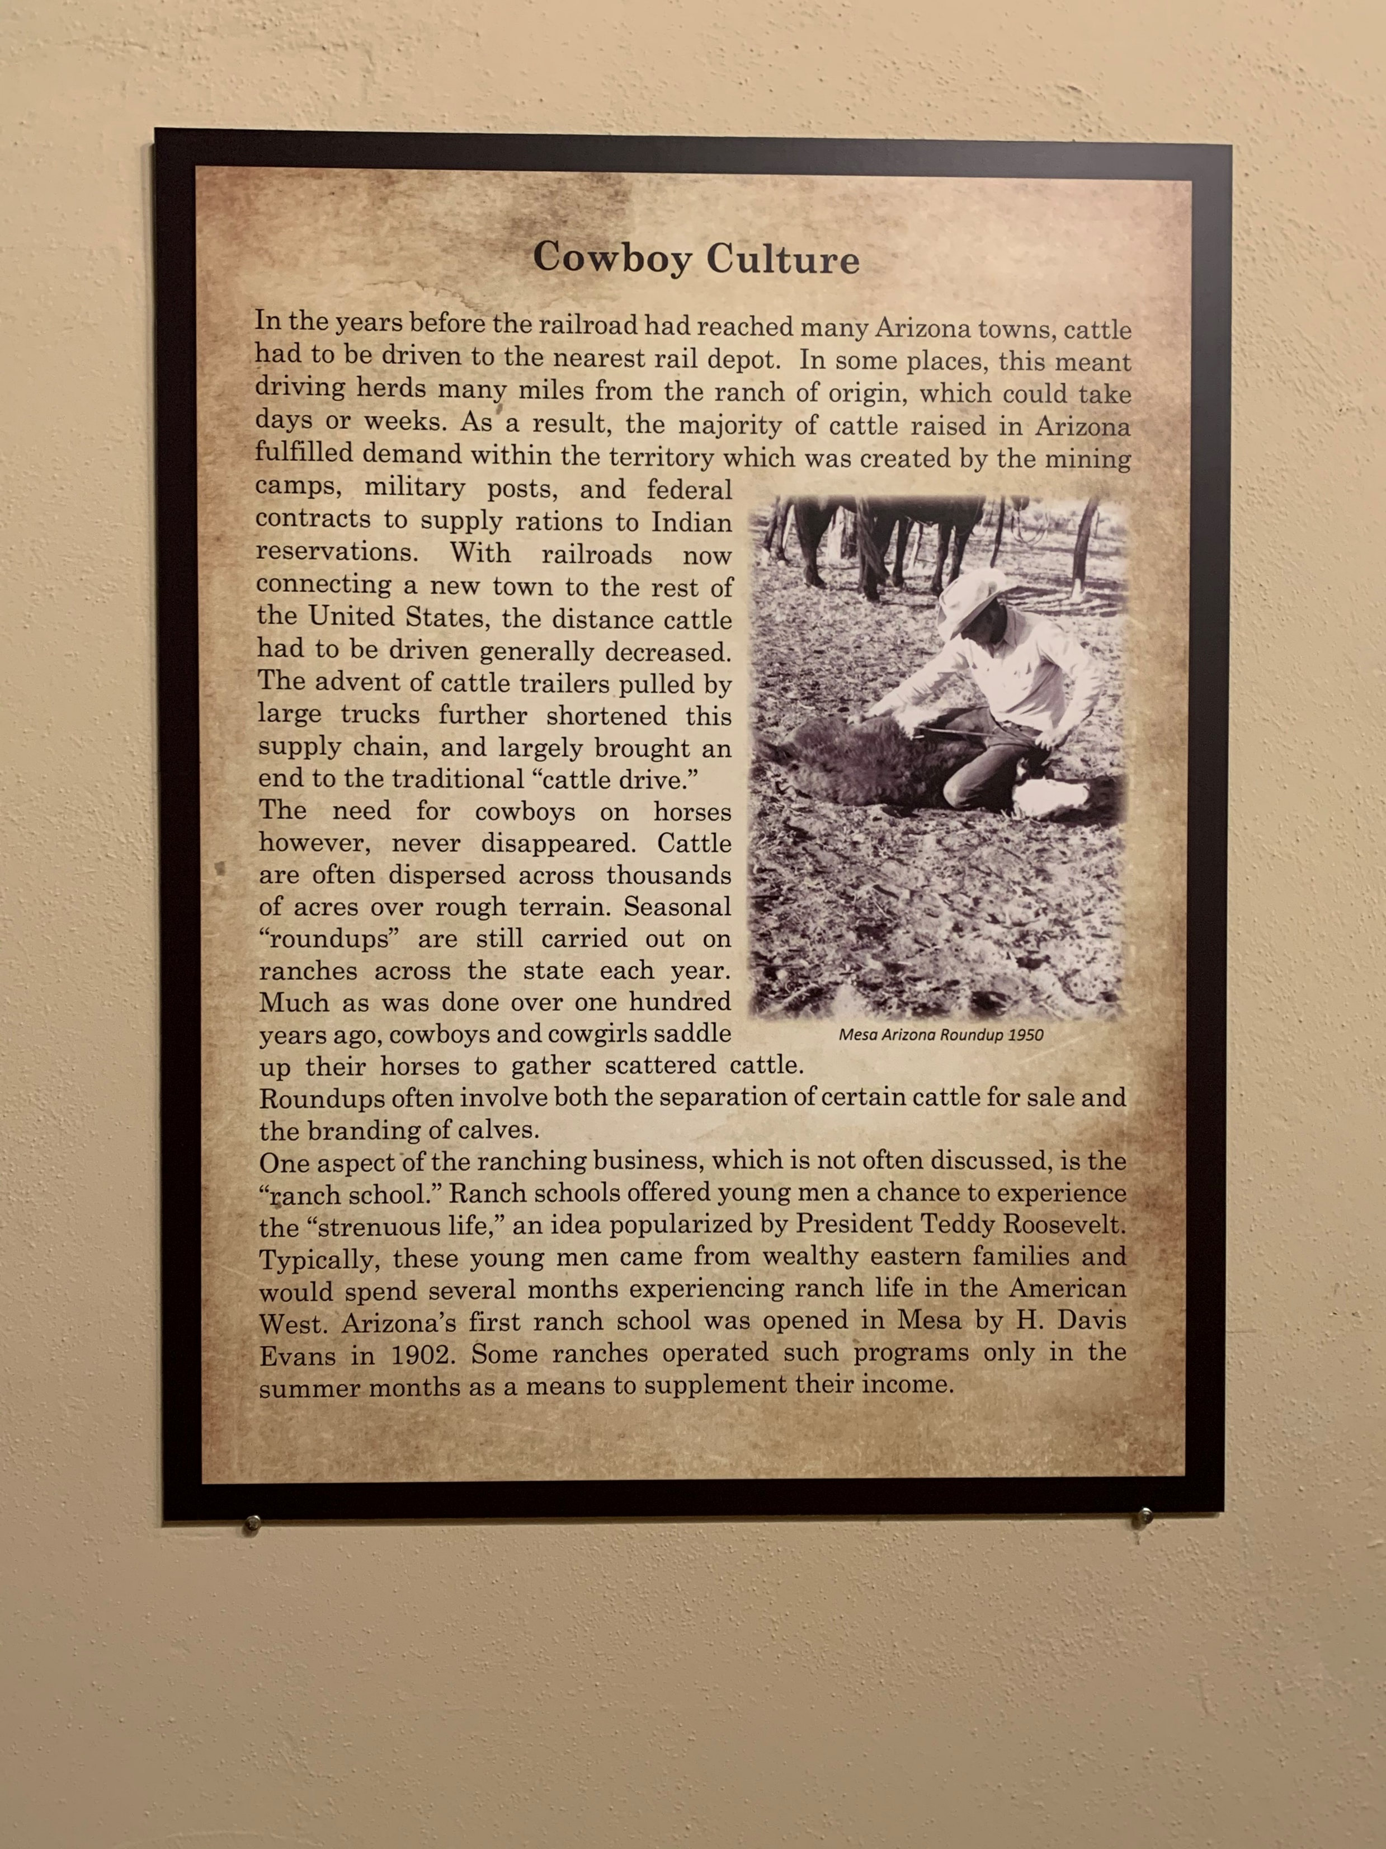

Slide 14
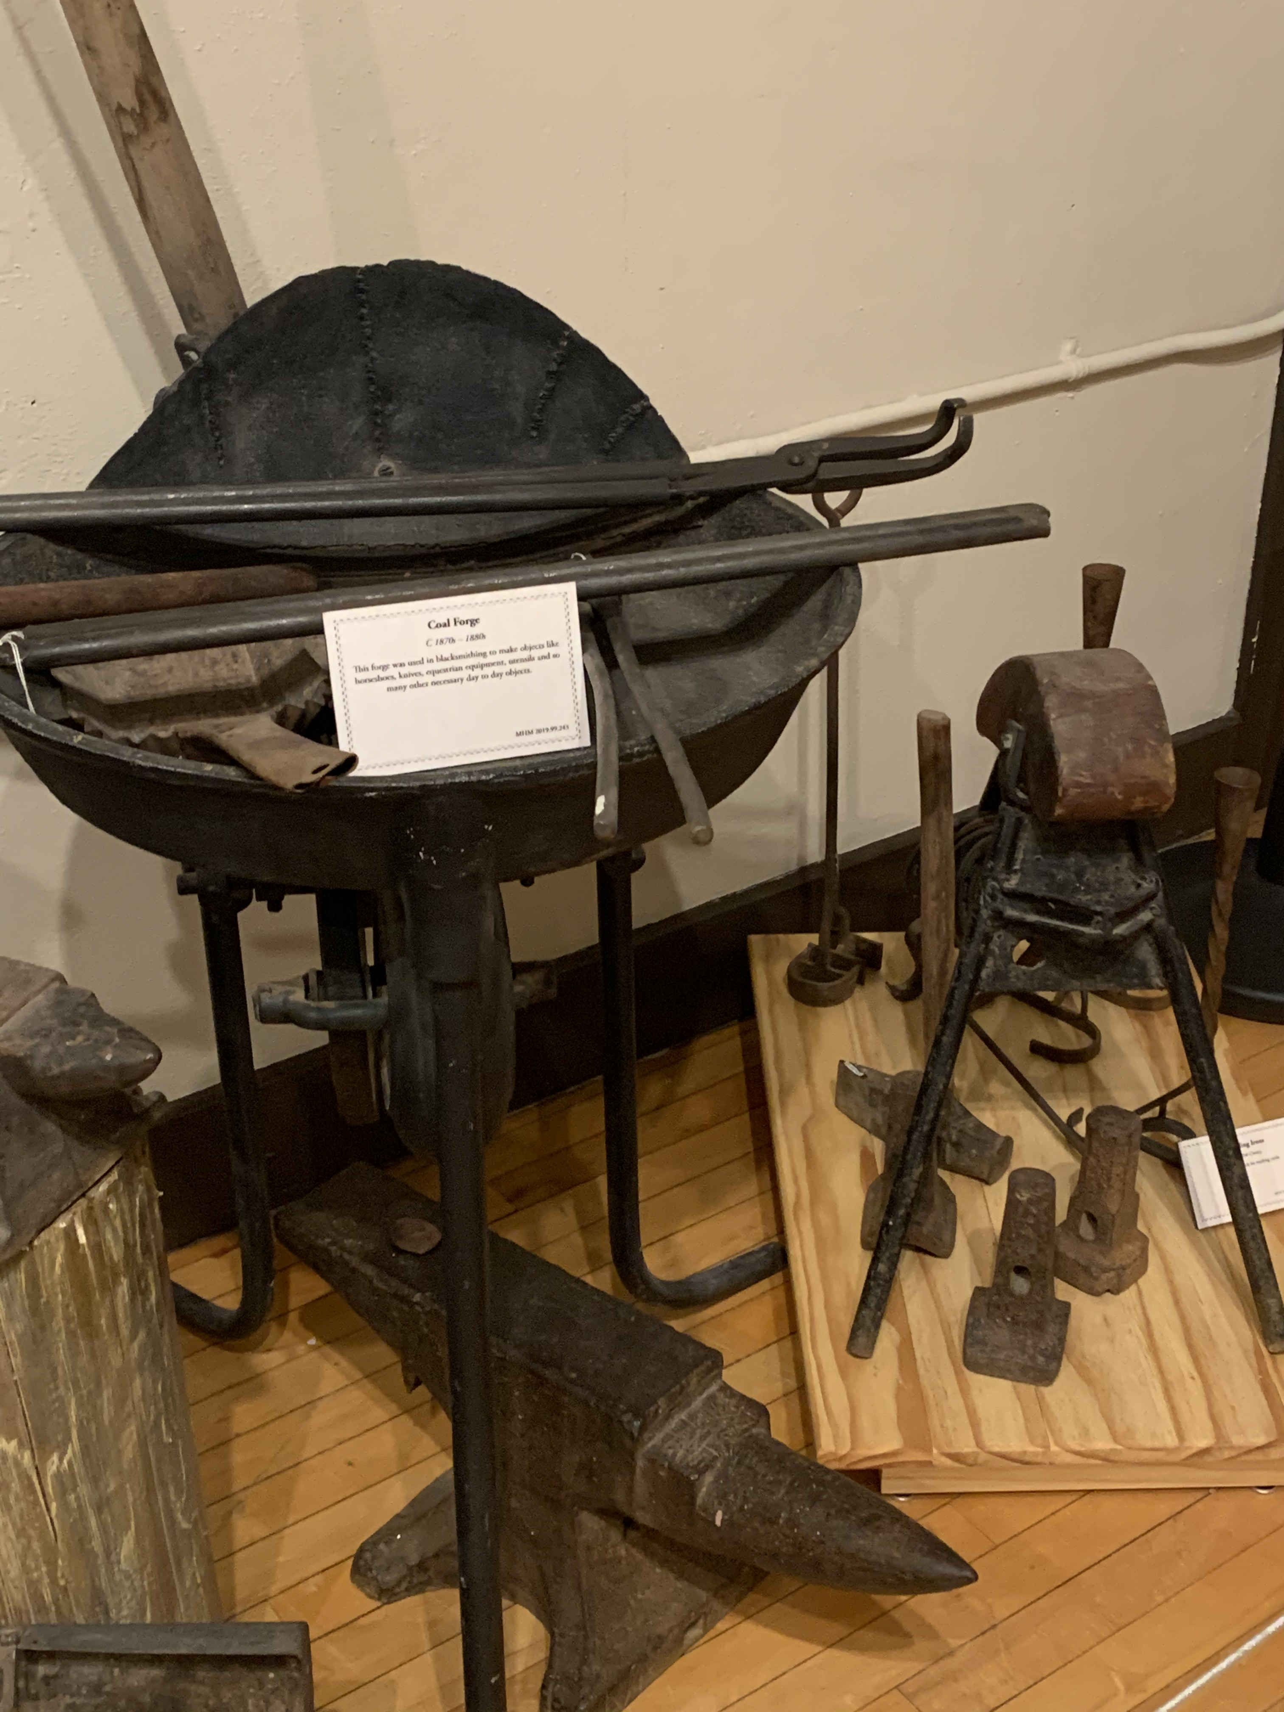
This coal forge was used in blacksmithing to make objects like horseshoes, knives, utensils and other necessary daily items. Circa 1870s

